Slide 1
SAP on Azure Technical Pitch Deck
Author name
Date

Slide 2
Digital transformation
Engage your customers
Transform your products
Empower your employees
Optimize your operations
According to Gartner, two-thirds of all business leaders believe that their companies must pick up the pace of digitalization to remain competitive.*
* Gartner, Smarter with Gartner, Embrace the Urgency of Digital Transformation, Oct. 30, 2017.

Slide 3
On-premises and hosted SAP environments can’t keep up
Manual/slow processes
Slow innovation
Poor insight
Key business processes are batch processed, manual tasks that are expensive and slow down functions across the business
The business is slow to innovate given the time it takes to experiment, set-up and tear down IT infrastructure resulting in long time to value
Data lives in silos, moves slowly, and is not properly combined with non-SAP data to drive better decision making
Notes:
Now, what are some challenges with driving business transformation if you’re currently running on-premises or in hosted environments?
First, data sources are now varied and no longer just in your ERP. Data can be unstructured from social and web along with newer mechanism such as IOT in addition to applications that might be on non SAP stack. As a business leader, you’re asked to deliver insights across the entire organization which means bridging these silos. We often hear customers still working with hours of manual excel wrangling to get to this type of insight or working with complex customer solutions that require long project cycles to implement at a significantly high cost to implement.
Current infrastructure on-premises or hosted is highly pre-planned with 3-5 year planning cycles and not ready for today’s fast paced innovation cycles to launch and learn new applications or business processes in weeks.
We also hear that many business processes in legacy SAP ERP systems are still manual. For example, some of you might have staff dedicated to optimizing supply chain or reconciling data between ERP and other systems.

Slide 4
A new digital core powered by SAP HANA® – in the cloud can power better business processes, innovation and insights
Faster, simpler processes
Accelerated innovation
360 insight
SAP HANA’s in-memory technology speeds up business process transactions and Azure offers a high performance infrastructure for SAP HANA
Accelerate innovation by removing barriers and time to set up systems, enabling fast experimentation –accelerating the build, measure and learn cycle
Generate compelling insights by aggregating SAP and non-SAP data to provide a 360° view of markets, transactions and customers
Notes:
The solution is to adopt SAP’s new digital core, S/4HANA running on an agile cloud platform such as Azure to power your innovation and insights.
With this now you have the ability to provide a unified view of your data across the enterprise by combing SAP and non-SAP data in the cloud,
accelerate innovation for agile product cycles with an on-demand infrastructure that you can spin up/down in minutes and finally take advantage of the advances in AI and machine learning to automate business processes.
With that, I’ll turn it over to Mark Skoog, to take us through how Azure uniquely enables this business transformation for your SAP applications. Mark, over to you.

Slide 5


Journey to SAP HANA and Cloud
On-premises
Multi-Vendor
Lift and Shift to Cloud
SAP AnyDB on Azure
S/4HANA on Azure
A
Migration to HANA, Conversion to S/4HANA
S/4HANA on Azure
Non-SAP,
Custom
SAP HANA on Azure
Analytics
B
Lift and Migrate to Cloud
Analytics
Non-SAP, Custom
Non-SAP,
Custom
Migrate to HANA
Non-SAP,
Custom
ERP,
Industry Add-ons
Industry solutions
Conversion to S/4HANA or BW/4HANA
Industry solutions
Non-SAP
Analytics
Any DB
Embedded analytics
Embedded analytics
ERP,
Industry Add-ons
S/4HANA
ERP,
Industry Add-ons
C
Lift and Shift/Migrate to Cloud, Migrate part to HANA
S/4HANA
HANA
HANA
D
Transformation to S/4HANA and Cloud: Consolidation or (selective) Re-implementation or Greenfield
Any DB
HANA

Slide 6
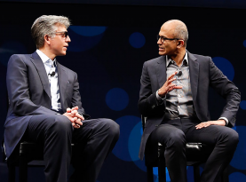
SAP and Microsoft partnership—the next chapter The trusted, optimized, seamless enterprise-ready cloud partnership
Trusted
20+ year alliance partnering together for the benefit of our mutual customers
Microsoft runs SAP and S/4HANA
SAP runs internal S/4HANA on Azure
Seamless
Co-located engineering resources & aligned sales and marketing teams provide a seamless customer experience
Optimized
Unique capabilities, roadmap, and experience to support SAP HANA & enterprise workloads from on-premises and Azure
“We are taking our partnership to the next level… Together, we will help companies win the customer-driven growth revolution...”
—Bill McDermott, CEO of SAP
“Building on our longtime partnership, Microsoft and SAP are harnessing each other’s products to not only power our own organizations, but to empower our enterprise customers to run their most mission-critical applications and workloads with SAP S/4HANA on Azure.”
—Satya Nadella, CEO of Microsoft
Notes:
SAP and Microsoft’s partnership has a deep history -- and is now being taken to the next level – with a shared commitment to empowering the digital transformation of our customers.
The relationship between our two companies is:
TRUSTED
We have a 20+ year alliance partnering together for the benefit of our mutual customers with
85% of Fortune 500 using SAP & Microsoft Cloud
Microsoft runs on SAP S/4HANA. SAP runs on Azure.
We are both running our businesses on our new joint solutions, so customers can invest in the cloud with confidence
OPTIMIZED
Together we have unique capabilities, roadmaps, and experience to support SAP HANA & enterprise workloads from on premise to the Azure cloud
Azure has unique capability to support SAP-specific enterprise workloads due to our joint development agreement
SAP has a level of influence in the Azure roadmap to better support SAP customers
Extensive work has gone into running hybrid SAP landscapes (across on-premise, private and public cloud).
SEAMLESS
Co-located engineering resources -- and aligned sales and marketing teams -- provide a seamless customer experience
Sales, marketing, engineering and support organizations are aligned and incentivized to work together
Microsoft provides scale in geographies where SAP customers have the greatest coverage requirements

Slide 7
Lift and shift SAP on AnyDB to Azure

Slide 8
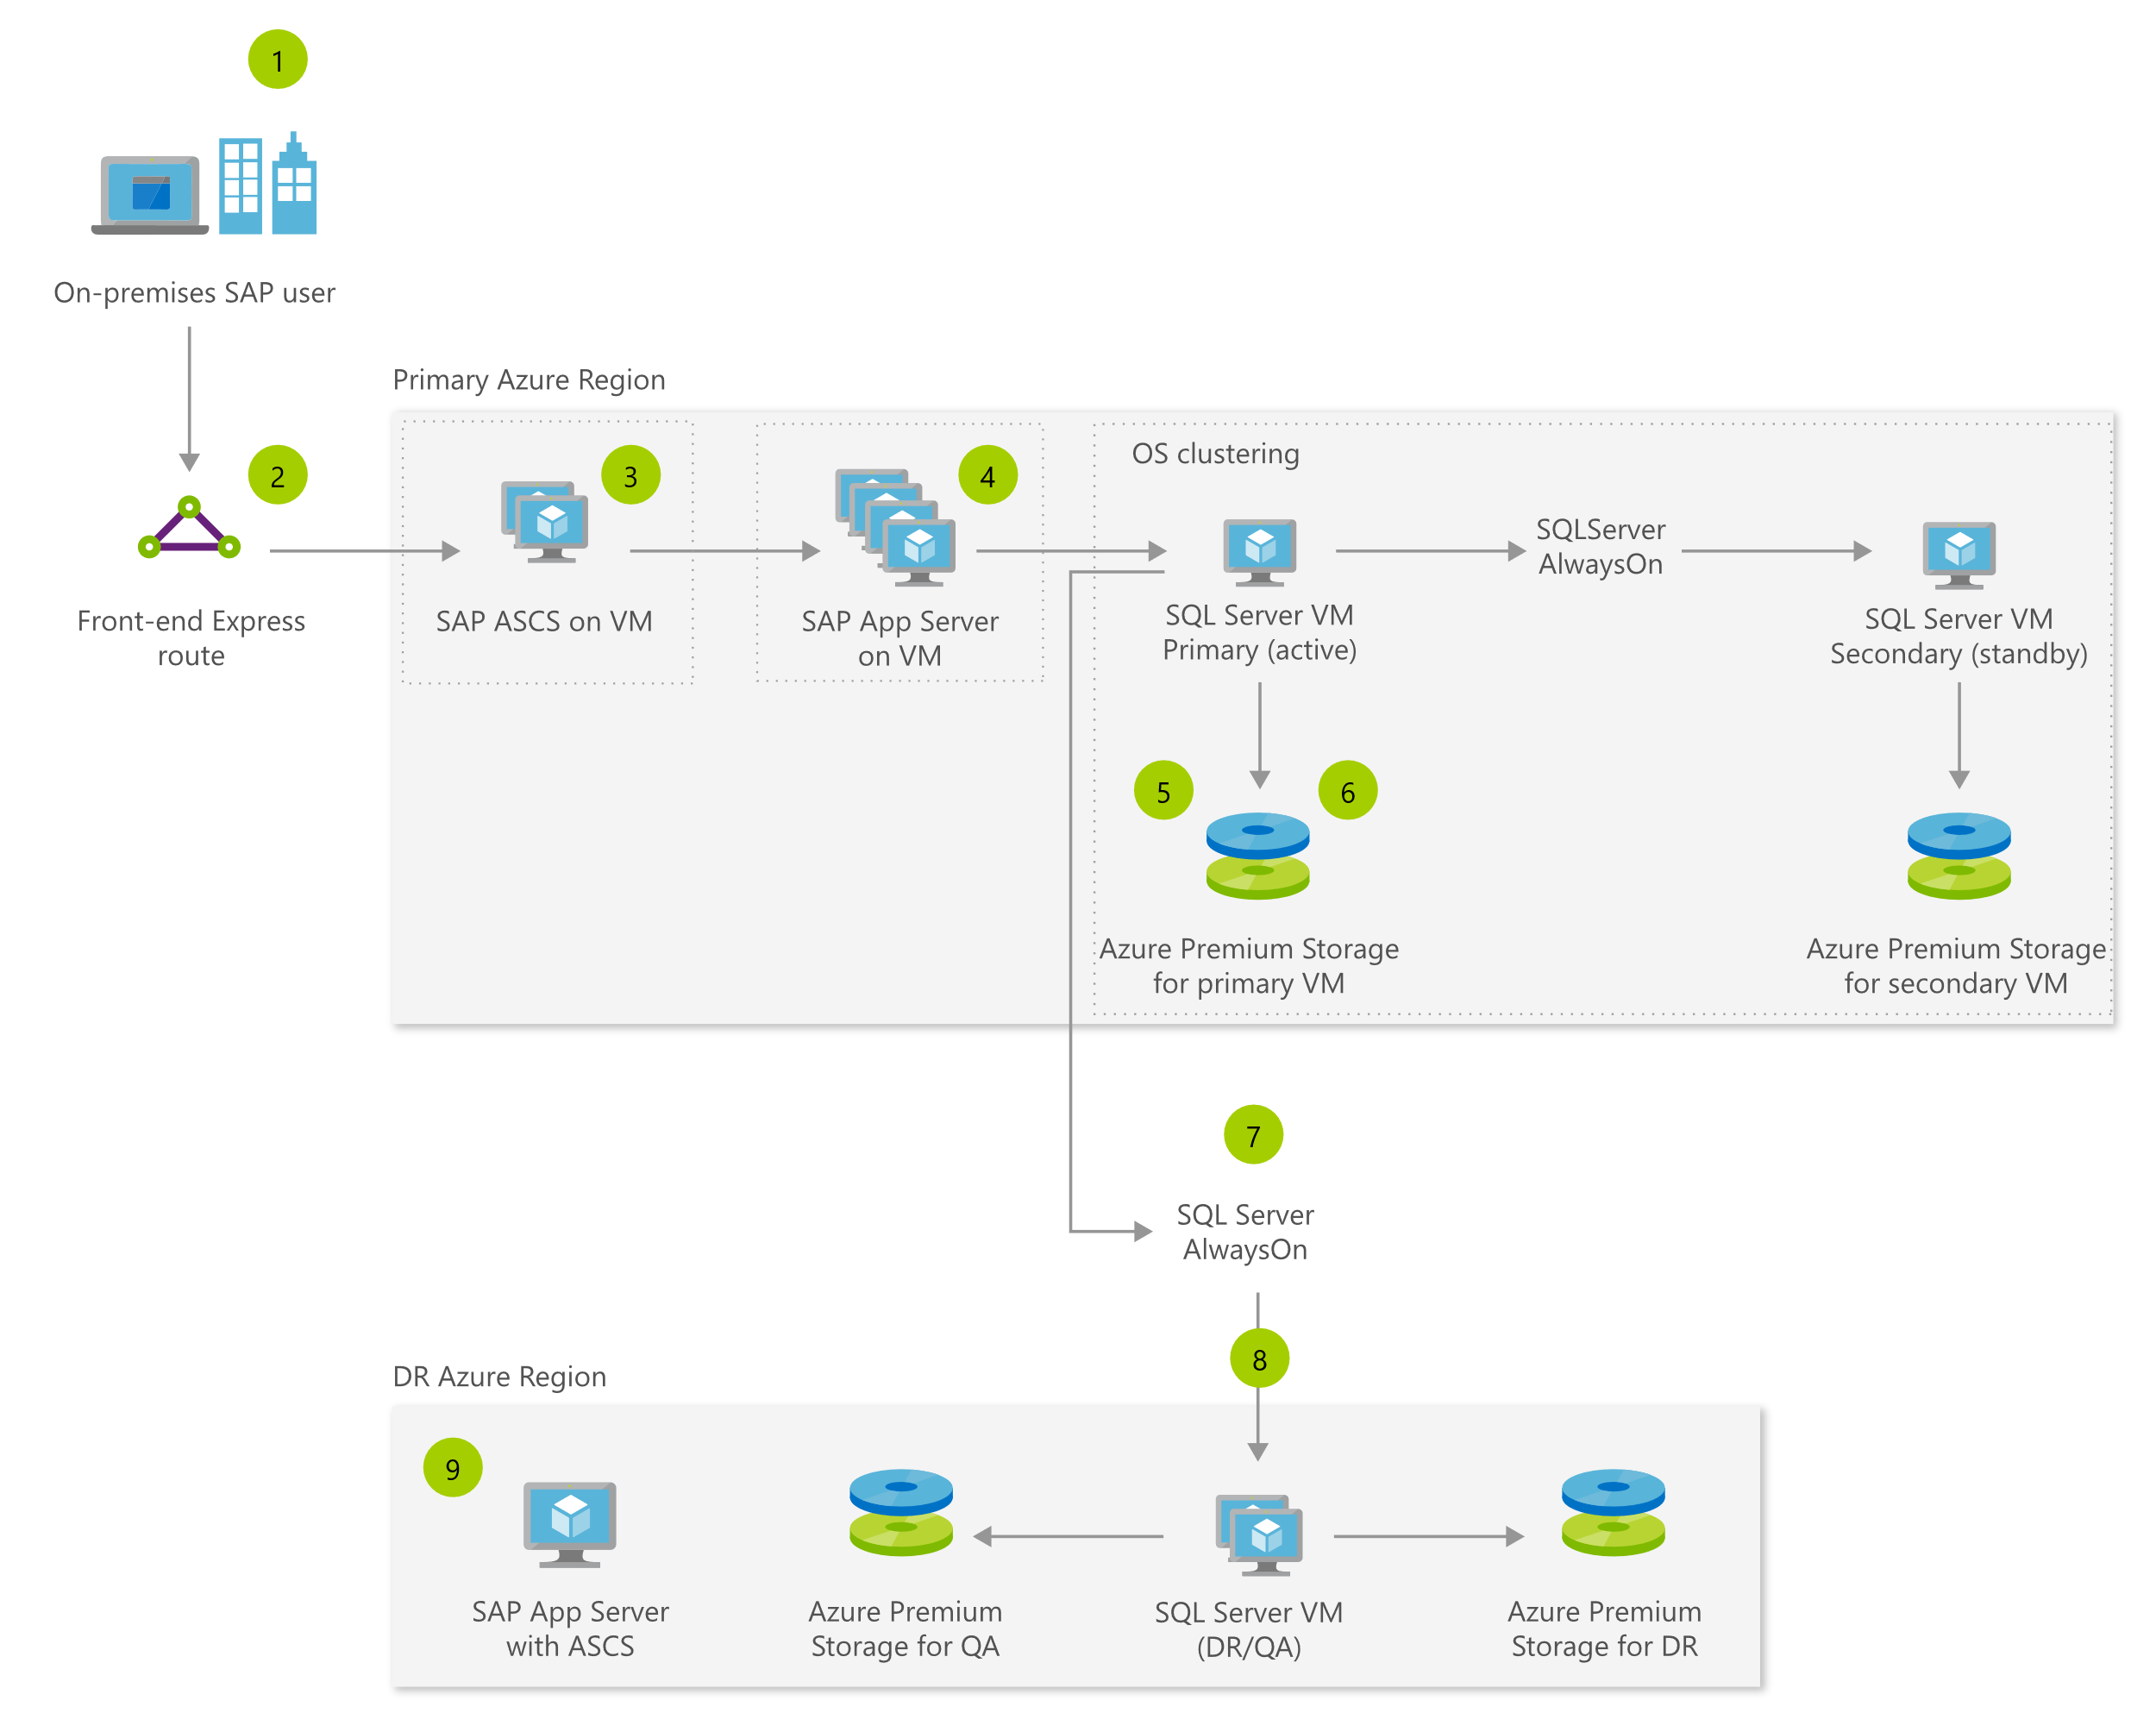



SAP ERP with AnyDB on Azure architecture
Azure VMs are on-demand and SAP NetWeaver certified for SQL Server, Oracle, IBM DB2, SAP ASE
Azure VMs offer up to 99.99% availability
Azure Premium Storage offers high performance
Azure region pairs and DB replication such as SQLServer AlwaysOn offers cost effective Disaster Recovery
ExpressRoute offers high speed secure connectivity to your users on-premises
On-premises SAP user
Primary Azure Region
OS clustering
SQL Server Always On
Front-end Express route
SAP ASCS on VM
SAP App Server on VM
SQL Server VM Primary (active)
SQL Server VM Secondary (standby)
Azure Premium Storage for primary VM
Azure Premium Storage for secondary VM
SQL Server Always On
DR Azure Region
SAP App Server with ASCS
Azure Premium Storage for QA
SAP HANA VM (DR/QA)
Azure Premium Storage for DR

Slide 9
Azure VM availability overview
VM SLA
99.9% with premium storage
VM SLA
VM SLA
99.95%
99.99%
Data residency
Single VM
Availability sets
Availability zones
Region pairs
Easier lift and shift
Protecting against failures within datacenters
Protection from entire datacenter failures
Regional protection within data residency boundaries

Slide 10
Lift and shift | Migrating SAP AnyDB to AnyDB on Azure
Azure Region
On-premises DB
MPLS WAN
ExpressRoute
ExpressRoute Gateway
SAP App Server on VM
AnyDB
Option 1: Backup/Restore method
Backup source SAP AnyDB Database
Copy backup into Azure
Restore in Azure VM that runs your DBMS instance
Set up log-shipping for changes to be applied to the Azure hosted instances
Stop the on-premise SAP instance.
Take a last transaction log backup and copy to the Azure hosted instance and apply
Start SAP system in Azure
Perform post-system copy tasks
Option 2: Export/Import method
Set up migration tools on-premise for exporting the SAP data and set up the components needed for importing on Azure
Shut down the SAP system hosted on-premise
Start export processes on-premise and start copying finished export packages into Azure
Start the import of copied packages into the Azure hosted DBMS instance while the export processes still create new export packages on-premise
Continue until all packages are exported and imported
Perform post-migration tasks

Slide 11
SAP on Azure Certifications (Any DB)
Category | Scenario | SAP Product | Guest OS | Database | VM/Server Type
SAP Any DB | - | SAP Business Suite 6.x (SAP NetWeaver Application Server 7.x) | Windows, SUSE, Red Hat, Oracle Linux *1 | SQL Server, ASE, Oracle, MaxDB, DB2/UDB | D/DS11_v2, D/DS15_v2, GS1 – GS5, D_v3, E_v3, M
 |  | SAP Business All-in-One
 |  | SAP NetWeaver Application Server 7.x (ABAP and Java)
 |  | SAP Business Objects Planning and Consolidation on NetWeaver
 |  | SAP Business Objects Planning and Consolidation Microsoft 10.01 | Windows | SQL Server
 |  | TREX 7.10 | Windows, SUSE, Red Hat *1 | N/A
 |  | SAP LiveCache, SAP Content Server 6.50 | Windows, SUSE, Red Hat *1 | MaxDB
 |  | SAP BusinessObjects BI Platform/Clients 4.1/4.2, Dashboards, WebIntelligence, Explorer, Analysis for OLAP, Design Studio, Crystal Reports, Lumira Server/Desktop/Designer, Data Services 4.2 | Windows, SUSE | N/A
 |  | SAP Business One (on SQL Server) | Windows Server | SQL Server
 |  | SAP Financial Consolidation 10.1 SP06 Patch 01 and higher | Windows Server | N/A
(*1) SUSE and Red Hat are certified only with ASE, DB2 and HANA. Oracle Linux is for Oracle. Windows Server is for all databases.
Notes:
This is the breakdown of Any DB and HANA / - list of SAP products / that are certified to run in Azure.
All SAP products with Any DB / are fully certified – such as SAP Business Suite, NetWeaver, Business Objects and Business one. The supported platforms are / Windows and Linux, / and SQL, ASE, Oracle, MaxDB and DB2/UDB. The VMs that you can use are / D v2 and G Series VM as of today / and D v3, E v3 and M Series VM / will be available later this CY.
All SAP products with HANA / are also certified – OLAP solutions like Business Warehouse, HANA Enterprise, Side Car / are certified with GS5 VM and HANA Large Instances. OLTP solutions like S/4HANA, Business Suite on HANA are good with Large Instances today, and with D v3, E v3 and M Series VM by the end of this CY.
Certification for Oracle Linux OS and SAP Business One on HANA is coming soon.

Slide 12
SAP on Azure Certifications (HANA)
Red : SAP certification is in future roadmap
Category | Scenario | SAP Product | Guest OS | Database | VM/Server Type
SAP HANA | OLAP | SAP Business Warehouse (BW); BW/4HANA, HANA Enterprise, HANA Side Car | SUSE, Red Hat | SAP HANA | GS5, HANA on Azure (Large Instances), E_v3, M
 | OLTP | S/4HANA | SUSE, Red Hat | SAP HANA | GS5 (** Controlled Availability), HANA on Azure (Large Instances), E_v3, M
 | OLTP | SAP Business Suite on HANA, SAP NetWeaver | SUSE, Red Hat | SAP HANA | HANA on Azure (Large Instances), E_v3, M
 | OLTP | SAP Business One on HANA | SUSE, Red Hat | SAP HANA | DS14_v2, E_v3, M
 | - | SAP HANA One | SUSE, Red Hat | SAP HANA | DS14_v2
Notes:
This is the breakdown of Any DB and HANA / - list of SAP products / that are certified to run in Azure.
All SAP products with Any DB / are fully certified – such as SAP Business Suite, NetWeaver, Business Objects and Business one. The supported platforms are / Windows and Linux, / and SQL, ASE, Oracle, MaxDB and DB2/UDB. The VMs that you can use are / D v2 and G Series VM as of today / and D v3, E v3 and M Series VM / will be available later this CY.
All SAP products with HANA / are also certified – OLAP solutions like Business Warehouse, HANA Enterprise, Side Car / are certified with GS5 VM and HANA Large Instances. OLTP solutions like S/4HANA, Business Suite on HANA are good with Large Instances today, and with D v3, E v3 and M Series VM by the end of this CY.
Certification for Oracle Linux OS and SAP Business One on HANA is coming soon.

Slide 13
Robust cost effective infrastructure for NetWeaver
SAP Business Suite on any DB (Oracle, IBM DB2, SAP ASE, SQL Server), and all SAP NetWeaver based applications are certified for production.
Dev, test & training
Disaster recovery as a service
Backup and archiving
Cost effective
Production
40–75% TCO cost savings for dev/test
Minutes Provisioning in minutes, not weeks/months
60% less storage costs for archiving data
40% less for Windows Server VM vs. other cloud options
37 Regions available with 99.95% SLA

Slide 14


Accelerating time to value with SAP on Azure
Organization size
55,000 employees
Revenues
33.78 USD
SAP landscape
24 SAP applications
2 environments with 8TB and 7.5TB database
35 TB of data
IBM DB2 to SQL Server
Business need
Respond to market conditions—pricing volatility in commodities
Business agility for proof of concept and innovation
Microsoft services
Azure VMs, Premium Storage, Azure Backup, Office 365
Business results
Vacated four datacenters and reduced operating costs by 30%
Foundation for supply chain productivity with IOT
Secure mobile access to field workers for company data and collaboration
Notes:
http://customers.microsoft.com/en-us/story/rio-tinto-mining-azure
Rio Tinto is a leading global mining and metals company, headquartered in Australia but they operate throughout the world.
A few years ago, Rio Tinto decided to undertake a massive transformational project that to modernize core enterprise IT systems to an “As-a-Service” solution based in the cloud
As a part of this they were looking for a cloud that could power all of their business processes which are based on SAP
SAP for Rio Tinto is mission critical with 40,000 users and 365 days a year operation. If their SAP application stops, their mining operations and trucks have to stop.
This is one of the largest deployment of SAP in the public cloud with a 8TB database size.
They chose Azure, and moved over 1000 servers, as well as migrated to SQL Server from DB2 in the process.
The customer saw significant benefits in business agility, such as scaling up for year-end peak demand and in addition some significant cost savings in the 20-25% range.

Slide 15


Microsoft runs SAP on Azure
Completed 50TB data migration to Azure in Feb 2018
Deliver reliant and agile ERP platform
Enable modern
experiences
Provide real-time
processes
SAP surround strategy
16TB Highly compressed database | 300K Monitored batch jobs/month | 4M Dialog steps/day | 110K Internal users (Mostly Indirect Access to SAP)
6K Named user accounts | 99.998% Raw SQL/Win uptime |  | 0.4 Seconds user response time
 | 170M Transaction steps/month | 5-7 % yearly Incident ticket reduction | 2X System growth in past 2 years
≈600 Servers | 250TB Compression storage savings | 2X Transaction volume over 18–24 months | 96% Non-SAPGUI users
Major first and best program
Uncompressed size >45TB
Business process expertise

Slide 16
Migrating from SAP on AnyDB to SAP HANA

Slide 17
SAP HANA Infrastructure on Azure
On-demand infrastructure
Purpose-built infrastructure
E-series VMs for dev/test & PoC
M-series VMs for most implementations
SAP HANA Large Instances for extreme scale & performance
Up to 0.5 TB RAM
Globally available
192 GB to 4.0 TB RAM
Available in U.S, EU, APAC, AU, JP, India now SAP HANA certified for production
0.7 TB to 24 TB RAM
Available in US, EU, AU, JP now
SAP HANA certified for production
Notes:
In Azure, we’re invested to give you highly scalable and performant infrastructure if you’re embarking on HANA.
Azure has virtual machines for dev/test, POCs as well as certified by SAP for production. They provide pay-as-you-go infrastructure with full certification for HANA and support upto ½ TB of RAM.
But we know SAP HANA systems can explode pretty quickly. So we’ve built specific hardware to give you unparalleled scale and performance. Called SAP HANA Large Instances they’re based on purpose-built infrastructure for HANA, are fully managed with 99.99% SLA and have up to 20 TB RAM per node for Scale-up OLTP workloads such as S/4HANA, Suite on HANA. Currently available for production in the US, EU and Australia. We are the only hyperscale public cloud provider that can offer up to 20 TB HANA certified instances. These instances can also support up to 60 TB for scale-out OLAP scenarios such as SAP Business Warehouse.
We’re also investing in VMs that are capable of handling large HANA workloads. We expect M-series VMs to be certified by SAP by end 2017, which will then sport up to 3.8TiB RAM per node. M-Series VMs will soon be Generally available in the US for Dev/Test workloads and we expect HANA certification to complete by end of CY17. We will also be launching M-Series in the coming months in EU, India and Japan regions soon.
Please refer to the NDA roadmap for details on launch timelines.

Slide 18
On-demand infrastructure for SAP HANA
4TB
M128ms
OLTP
Hyper-threaded VMs
Intel® Xeon® E7-8890 v3 processor
DDR4 memory
<1ms latency for storage writes
Flexible CPU to memory options
Available in 10 regions today and 12 more launching by end of 2018
On demand pricing
82% savings with 3-year reserved VM instances
Deployment in minutes with automation templates
OLTP & OLAP (single-node)
3TB
M128s
Memory (in GiB)
M64ms
2TB
M64s
M32ms
1TB
M64ls
512
M16ms
M8ms
M32ls
256
M32ts
219
8
16
32
64
128
vCPUs

Slide 19
Purpose-built infrastructure for SAP HANA
24
S768xm
OLAP
S960m
SAP HANA TDI configuration
Intel® Xeon® processor E7-8890 v4
Persistent NFS storage
Scale-up to 24TB and scale-out to 60TB
Built-in online backup in seconds with snapshots
Available in 8 regions in US, EU, AU, and JP
TDIv5 SKUs allow lower price/TB scaling
99.99% SLA for HA Pair
22
OLTP
20
S576xm
OLTP TDIv5
8
S768m
18
16
14
S384xxm
S576m
12
Memory (in TB)
10
S384xm
S192xm
S384m
6
S192m
S384
4
S72m
S192
2
S72
S96
0
72
192
384
576
768
960
CPU threads

Slide 20
SAP HANA on Azure VM Architecture
On-premises SAP user
HANA on M-series VMs can be made highly available with OS clustering such as Fencing and Stonith on SUSE or RedHat
App Server VMs are made highly available with Azure VM availability set
M-series VMs offer Write Accelerator for high performance
HANA System Replication (asynchronous) enables DR configurations
Primary Azure Region
OS clustering
HA via HSR
Front-end Express route
SAP ASCS on VM
SAP App Server on VM
SAP HANA VM Primary (active)
SAP HANA VM Secondary (standby)
Azure Premium Storage for primary VM
Azure Premium Storage for secondary VM
HSR Asynchronous
DR Azure Region
SAP App Server with ASCS
Azure Premium Storage for QA
SAP HANA VM (DR/QA)
Azure Premium Storage for DR

Slide 21

SAP HANA on Azure HANA Large Instance Architecture
On-premises SAP user
HANA on HLIs can be made highly available with OS clustering such as Fencing and Stonith on SUSE and data replication via HSR
App Server VMs are made highly available with Azure VM availability set
HANA Large instances offer high performance NFS storage with <1ms write latency
HLIs are connected with a 40GB network
Storage snapshot replication offers built-in disaster recovery
Primary Azure Region
OS clustering
HA via HSR
Front-end Express route
SAP ASCS on VM
SAP App Server on VM
Back-end Express route
SAP HANA Large Instances Primary (active)
SAP HANA Large Instances Secondary (standby)
Snapshot
NFS storage Primary
NFS storage Secondary
HA Pair
DR Azure Region
DR storage replication
QA (NFS) Storage
SAP HANA Large Instances (DR/QA)
DR (NFS) Storage

Slide 22
Migrate from AnyDB on-premises to HANA on Azure
Azure Region
On-premises AnyDB
MPLS WAN
ExpressRoute
ExpressRoute Gateway
SAP App Server on VM
SAP HANA DB
Install a new SAP application server and HANA Database on Azure. This can be done through predefined Azure ARM templates
Run export using the SAP Data Migration Options (DMO) system move tool for the on-premise SAP server
Upload finished export files to Azure through ExpressRoute from the on premise SAP server in sequential or parallel mode
Parallel mode is used to minimize downtime
Run import using SAP DMO System Move option in Azure
Run all post-migration steps for the Azure SAP App server

Slide 23
Migrate from HANA on-premises to HANA on Azure
Azure Region
On-premises HANA DB
MPLS WAN
ExpressRoute
ExpressRoute Gateway
SAP App Server on VM
SAP HANA DB
Database size < 1 TB
Database size > 1 TB
Install a new SAP application server and HANA DB server on Azure. This can be done through predefined Azure ARM templates
Take a full database backup for the on-premises SAP HANA Database server
Upload backup files to Azure through ExpressRoute
Restore HANA database in Azure
Run post-migration steps for the Azure SAP Application server
(Optional) Set up HANA System Replication to replicate production database to Azure to minimize migration downtime
Install a new SAP application server and HANA DB server on Azure. This can be done through predefined Azure ARM templates
Setup HANA System Replication (asynchronous) from Source system on-premises to Azure
Once the data is fully replicated to Azure, switch to HANA System Replication (synchronous) for a final sync on data
Run post-migration steps for the Azure SAP Application server
(Optional) Set up HANA System Replication to replicate production database to Azure to minimize migration downtime

Slide 24
Only enterprise-grade SAP HANA environment in public cloud
Primary
Secondary
M
S1
S2
SB1
SB2
HSR
STONITH
OLTP – Scale up to 24 TB Up to 20 TB certified with 99.99% SLA
HA with automatic failover
OLAP - Up to 60 TB certified with 99.99% SLAs
N+M scale out for cost effectiveness
Automatic host failover
Single node SLAs
Integrated backup and disaster recovery
Live, consistent, full snapshots in seconds
Scheduled - Every 8 hours, daily, weekly
Point in time recovery
Mirrored snapshots at a paired datacenter located >500 Kms away

Slide 25
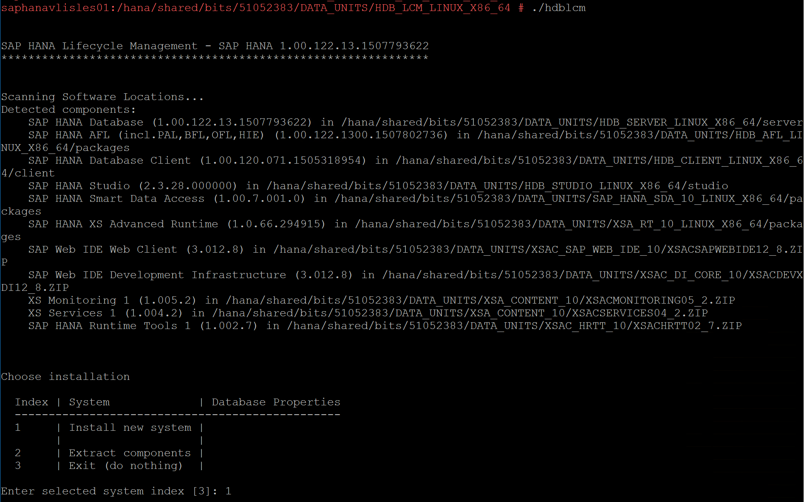
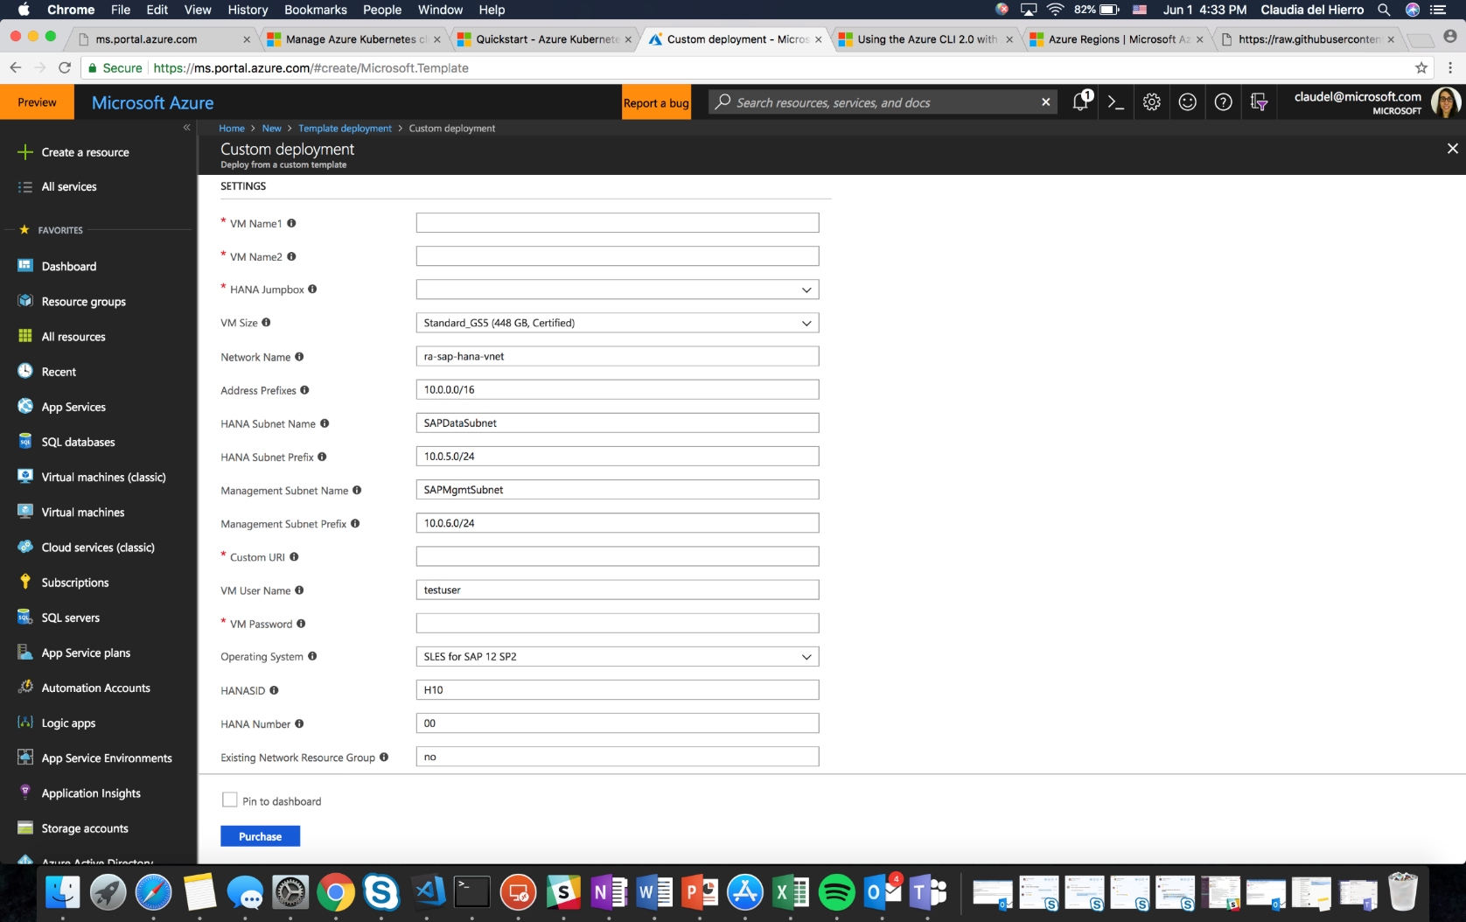
Azure offers automation to simplify HANA installations in minutes in a consistent error-free way
HANA installation without Azure Automation
HANA installation with Azure Automation
Tedious and error prone manual installation that takes hours or days if multiple installs required
Guided error-free reference architecture installation for compute, storage, network and HANA including High Availability in just minutes

Slide 26


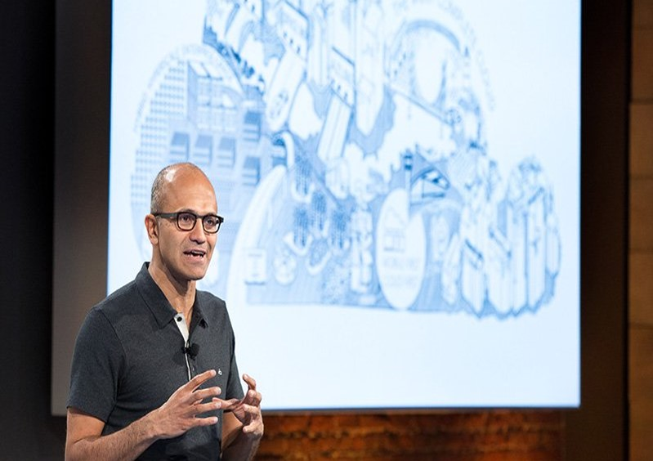
Trusted performance with SAP HANA on Azure
Organization size
19,000 employees
Revenues
1.45B GBP
SAP landscape
60 manufacturing sites
180+ servers
4 regional ECC instances, 1 central ECC, 1 BW and 1 APO module
Oracle to HANA
Business need
On-demand infrastructure for new markets
Faster reporting
Azure services
Azure VMs, Large Instances, Storage, ExpressRoute, Azure Active Directory
Business results
Same day factory production planning vs. overnight batch jobs
Ability to insert rush orders same day vs. 48 hours wait time
Real-time reports on sales orders and shipment status
“The performance boosts from running SAP on HANA in Azure have been remarkable. Transactions times have been reduced considerably in many cases. Reports that previously took 6 hours to produce now take 6 minutes.”
Notes:
Let’s talk about one company that’s going through such a transformation – Coats and Clarke.
Founded in 1700s during industrial revolution, it has stayed relevant for 265 years. Today, 7,000 information workers spread across 160 worldwide locations and 70 manufacturing facilities. Interesting fact about Coats that I learnt: Most of you might be coffee drinkers, but I’m more of a tea person. It was fascinating to find out every week, coats threads are used for 1 billion tea bags. They make enough thread in a year to go into the equivalent of 8 billion pair of jeans. Clearly, you can imagine the scale of their manufacturing operations.
Problem:
Coats had state-of-the-art factories around the world, but manufacturing was siloed geographically; products that were manufactured in one country were sold in that country.
Coats wanted a more unified view and flexible use of its global manufacturing capacity.
could not easily produce reports across 60 different factories, which means that they could not get a holistic view of the business.
The SAP reports took hours to generate, which created delays of up to 48 hours in business decisions.
Additionally, the company’s datacenter infrastructure was not agile enough to serve the dynamics of modern markets.
Coats needed to spin up customer demonstration environments in hours and to launch test environments so that software developers could play with a new application.
But it took weeks to order and provision servers, and it was impossible to scale infrastructure selectively in various locations.
For example, the company was experiencing dynamic growth in China but couldn’t deliver enough web performance for web visitors in China to play online product demonstration videos.
Expanding in China also meant offering secure e-commerce services, which was difficult to do.
Solution:
Coats made a strategic decision to embrace cloud computing so it could gain the infrastructure elasticity and resilience it needed to run a global business and minimize the time its staff spent on datacenter tasks.
“Deploying servers and managing email are not our core competencies,” says Groothedde. “Let someone else take care of that.”
HANA journey: For years, Coats used the Oracle database with its SAP applications. However, to improve SAP performance, it decided to switch to the SAP HANA database, which features high-performance in-memory technology.
Why Microsoft?
Coats evaluated all the major cloud providers—Amazon, Google, and Microsoft—and felt that Microsoft was the best partner to complement its existing service portfolio and strategic technology direction. “The breadth and scale of the Microsoft cloud was impressive,” says Cammish.
“It had Office 365 on the desktop productivity side and Azure on the datacenter side. We could use Azure Active Directory Premium to provide single sign-on for all applications, from email to SAP, which would support our ‘invisible technology’ objective.”
Azure provided security far in excess of what they could of achieved on premise with direct integration to AD and O365
HANA Journey
Coats was one of the early customers to work with us on running SAP HANA on Azure. They run on G series VMs, HANA Large Instances, Azure Storage, Azure ExpressRoute, for high-performance connectivity between Coats and global Azure datacenters and AD for Single Signon.
Moved over 180 Servers into Azure and our entire SAP environment in 3 months
Results
The performance boosts from running SAP on HANA in Azure have been eye-popping. Transactions that previously took 12 hours now take 12 minutes. Reports that previously took 6 hours to produce now take 6 minutes. 600% improvement.
By speeding up SAP, they’ve sped up the whole business.
They can do same-day factory production planning versus having to run scheduling jobs overnight.
You can insert rush orders into the production schedule the same day versus waiting 24 to 48 hours. The whole production engine has sped up.
The company is moving into the services business, advising customers on their manufacturing processes and helping them predict how much thread they’ll need to manufacture particular garments.
Crunching massive amounts of data becomes very complex very fast, and the ability to scale Azure resources on demand lets Coats meet more customer needs.
They use PowerBI for visualization and SAP BusinessObjects to instantly see data from multiple sources as graphical dashboard-style reports.
Data is know be integrated into Azure IOT Hub, DW, Hadoop and visualized and analyzed by Azure ML

Slide 27
Migrate to S/4HANA

Slide 28
S/4HANA migration is not just a technical migration
S/4HANA simplifies many of the ERP business processes
Customers need to evaluate and understand the impact of current ERP processes changes in S/4HANA
Decide on system conversion vs. a greenfield approach
System conversion to S/4HANA
Greenfield implementation of S/4HANA
Review SAP simplification item catalog that describes changes in S/4HANA that could have an impact on older SAP ERP
Check for 3rd party applications certification for S/4HANA
Prerequisites for conversion
Upgrade to ECC 6.0 EHP7
Unicode compliance
Minimizes impact to End users
Evaluate Fiori UI and Apps
Take a fresh start approach to refresh legacy customizations
Start with some key business processes first to pilot
Moving from Non SAP ERP or other legacy systems
Requires training end users with new processes
Platform for future modernizations with S/4HANA roadmap

Slide 29

SAP Cloud Platform on Azure
Develop SAP applications on SAP Cloud Platform running on Azure
Co-locate your applications and ERP data for low latency
Unified cloud for your SAP infrastructure and development
Several enterprise customers run Pivotal Cloud Foundry on Azure: Ford, Manulife, and the Merrill Corporation
Leverage Azure PaaS services for containers and Kubernetes
Get started now!

Slide 30


Digital transformation with S/4HANA on Azure
Organization size
10,000+ employees
Revenues
164B Euros
SAP landscape
SAP S/4HANA Green field implementation
SAP Supplier Relationship Management (SRM)
SAP Fiori
SUSE Linux OS
Business need
Connected Cars and compete with new entrants
Faster procurement system to support innovation velocity
Azure services
Azure services
Business results
Agility to update systems every day if required vs. twice a year
Provision new resources for peak usage demand in 30 minutes
50% cost savings compared to older system
“We could only update our previous purchasing system a couple of times a year. With NPS running in Azure, we can issue updates every day if necessary.”
Dr. Stephan Stathel, Operations Lead for New Procurement System
Notes:
Let’s talk about one company that’s going through such a transformation – Coats and Clarke.
Founded in 1700s during industrial revolution, it has stayed relevant for 265 years. Today, 7,000 information workers spread across 160 worldwide locations and 70 manufacturing facilities. Interesting fact about Coats that I learnt: Most of you might be coffee drinkers, but I’m more of a tea person. It was fascinating to find out every week, coats threads are used for 1 billion tea bags. They make enough thread in a year to go into the equivalent of 8 billion pair of jeans. Clearly, you can imagine the scale of their manufacturing operations.
Problem:
Coats had state-of-the-art factories around the world, but manufacturing was siloed geographically; products that were manufactured in one country were sold in that country.
Coats wanted a more unified view and flexible use of its global manufacturing capacity.
could not easily produce reports across 60 different factories, which means that they could not get a holistic view of the business.
The SAP reports took hours to generate, which created delays of up to 48 hours in business decisions.
Additionally, the company’s datacenter infrastructure was not agile enough to serve the dynamics of modern markets.
Coats needed to spin up customer demonstration environments in hours and to launch test environments so that software developers could play with a new application.
But it took weeks to order and provision servers, and it was impossible to scale infrastructure selectively in various locations.
For example, the company was experiencing dynamic growth in China but couldn’t deliver enough web performance for web visitors in China to play online product demonstration videos.
Expanding in China also meant offering secure e-commerce services, which was difficult to do.
Solution:
Coats made a strategic decision to embrace cloud computing so it could gain the infrastructure elasticity and resilience it needed to run a global business and minimize the time its staff spent on datacenter tasks.
“Deploying servers and managing email are not our core competencies,” says Groothedde. “Let someone else take care of that.”
HANA journey: For years, Coats used the Oracle database with its SAP applications. However, to improve SAP performance, it decided to switch to the SAP HANA database, which features high-performance in-memory technology.
Why Microsoft?
Coats evaluated all the major cloud providers—Amazon, Google, and Microsoft—and felt that Microsoft was the best partner to complement its existing service portfolio and strategic technology direction. “The breadth and scale of the Microsoft cloud was impressive,” says Cammish.
“It had Office 365 on the desktop productivity side and Azure on the datacenter side. We could use Azure Active Directory Premium to provide single sign-on for all applications, from email to SAP, which would support our ‘invisible technology’ objective.”
Azure provided security far in excess of what they could of achieved on premise with direct integration to AD and O365
HANA Journey
Coats was one of the early customers to work with us on running SAP HANA on Azure. They run on G series VMs, HANA Large Instances, Azure Storage, Azure ExpressRoute, for high-performance connectivity between Coats and global Azure datacenters and AD for Single Signon.
Moved over 180 Servers into Azure and our entire SAP environment in 3 months
Results
The performance boosts from running SAP on HANA in Azure have been eye-popping. Transactions that previously took 12 hours now take 12 minutes. Reports that previously took 6 hours to produce now take 6 minutes. 600% improvement.
By speeding up SAP, they’ve sped up the whole business.
They can do same-day factory production planning versus having to run scheduling jobs overnight.
You can insert rush orders into the production schedule the same day versus waiting 24 to 48 hours. The whole production engine has sped up.
The company is moving into the services business, advising customers on their manufacturing processes and helping them predict how much thread they’ll need to manufacture particular garments.
Crunching massive amounts of data becomes very complex very fast, and the ability to scale Azure resources on demand lets Coats meet more customer needs.
They use PowerBI for visualization and SAP BusinessObjects to instantly see data from multiple sources as graphical dashboard-style reports.
Data is know be integrated into Azure IOT Hub, DW, Hadoop and visualized and analyzed by Azure ML

Slide 31
Insights from SAP and non SAP data with Azure

Slide 32









Intelligence to transform data to insights
Non-SAP data sources
People
Web
SAP data sources
Combine relevant data
Visualize
Analyze
Apps
Mobile
Sensors & devices
Automated systems
Bots
Data
Intelligence
Action
Notes:
We talked a bit about Azure provides a solid infra foundation so you can quickly get started with your SAP workloads. Let’s now shift our attention to how you drive some meaningful DT.
50-60% of data for SAP customers sits in non SAP environments. Not to mention with IoT new sensor data that flows in. You need a platform that can combine all of these source, give you powerful visualization, help you in the analysis, and then take meaningful action. Azure has a rich set of services – we collectively call Cortana Intelligence suite – that does just that. You can use services such as HDInsight for Big Data, Power BI for visualizing, and Azure ML for analyzing and building predictive models. And once you have meaningful insight, you can drive projects to take action on Azure as well – you can build apps, bots and so on … all inside of Azure.
So Azure not only provides you a solid infra foundation for your SAP applications, but also provides an intelligent cloud to get the most out of your SAP investments.

Slide 33

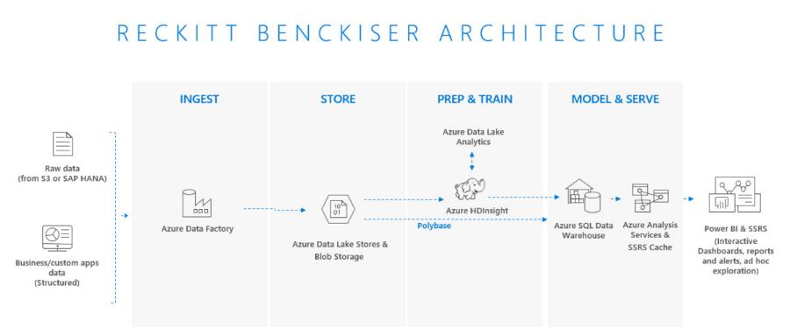

Business insights with SAP data on Azure
“Data is most powerful when it’s accessible and understandable. With this Azure solution, our employees can query the data however they want versus being confined to the few rigid queries our previous system required.”
—Wilmer Peres Information Services Director Big Data and Analytics Reckitt Benckiser

Slide 34


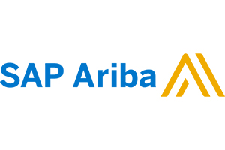


Innovation | The next chapter with Azure & SAP
Industry solutions
Business insights
ISV solutions
Azure: IoT, ML, Big Data, Chatbot, Mobile
Azure IaaS for SAP
VM & Bare Metal from 192GB-24TB
SAP Cloud
Azure Security & compliance
AAD - Only SSO that works across the SAP Portfolio
Partner Managed Solutions & Migrations including SAP HEC

Slide 35
Beyond ERP | Industry & horizontal focus
Industry Solutions
Horizontal Solutions
Extend Product Revenue Streams
Consumer Goods/Retail
Connected Supplier
Trade Promotion Management
Sku cannibalization
Price Volume Mix
Manufacturing
Remote Monitoring
Preventive Maintenance
IoT – Field monitoring & Sevice
Healthcare, Utilities, & Fin-serv in roadmap
Connected Supply Chain
Business Insights (AI/ML/Big Data)
Profitability
Customer Churn
Risk Management
Social Integration
Self-Service Insights
Omni Channel Integration (Adobe & SAP C4)
SAP Enterprise Information Management (OpenText on Azure)
Transforming MAD (Merger, Acquisition, & Divestiture) with SAP on Azure
ML/AI/PowerBI
Big Data (ADLS & Cosmos)
SQL Server PaaS & DW
SCP/Leonardo
IoT
Containers, Kubernetes (AKS), & Cloud Foundry
Blockchain
Mobile for SAP
Azure Stack (Extend Data to SAP)

Slide 36
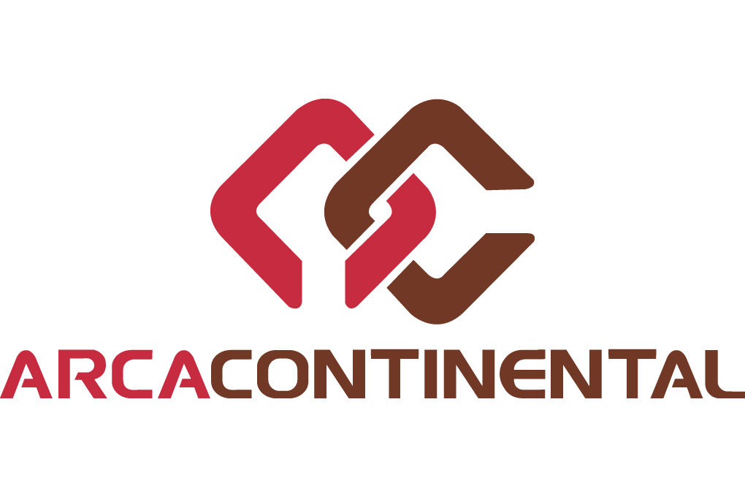











































SAP on Azure customers
Retail, food, & CPG
Manufacturing, mining, and oil & gas
Utility, pharma, services, and multi-sector
Notes:
Need some visuals that are industry specific and logos based on that.

Slide 37













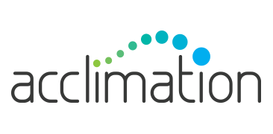



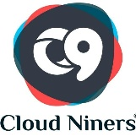






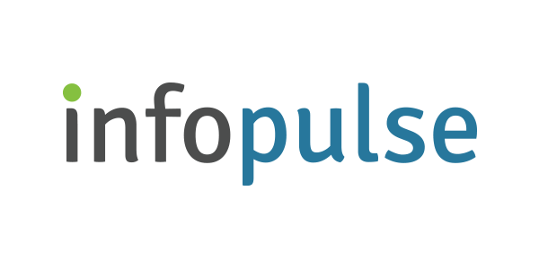
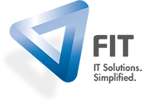



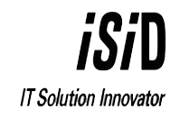








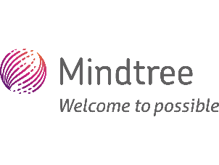













SAP on Azure partners
Global SI Partners
Regional/Local SI Partners

Slide 38
SAP HANA Enterprise Cloud (HEC) with Azure A premium solution that gives customers the best of both worlds
SAP provides end-to-end managed services for in-memory applications, database, and platform
Azure provides best-in-class infrastructure and a wide range of enterprise-ready services
Azure offers global coverage across high-demand regions
Premium solution built on a trusted partnership, optimized for SAP in the enterprise, providing a seamless customer experience
Supports up to 2.0 TB HANA DB with roadmap for larger HANA configurations soon
HEC App Managed Services (AMS)) | Solution & services stack
HEC App Managed Services (AMS) | App evolution, functional and change management
HEC Cloud and Managed Services | SAP HANA DB, O/S maintenance, and backup management
Azure | Connectivity, Infrastructure, H/W maintenance, and datacenter

Slide 39
Why Azure for SAP workloads
Deep partnership and unique offering from SAP and Microsoft
20+ year partnership
SAP is migrating 17 internal systems on Azure including S/4HANA for a business unit
Microsoft runs SAP and S/4HANA for central finance
Get the best of both worlds in managed services and infrastructure with SAP HANA Enterprise Cloud with Azure
Most powerful and scalable cloud for SAP HANA
Up to 4 TB SAP HANA certified VMs available worldwide, more regions of any public cloud
Largest SAP HANA workloads (up to 24TB of RAM) of any hyperscale public cloud provider, bigger than AWS
Scaling out to 60 TB RAM for HANA OLAP, with single-node support up to 24 TB for HANA OLTP
Enterprise-proven + most secure
Largest compliance portfolio— 72 compliance certifications including tools for GDPR
Best platform for digital transformation—take advantage of high-level services like IoT, data, ML, and Power BI for insights
Broad database support: As you prepare for HANA, you can bring in your existing applications using Oracle or SQL Server

Slide 40
Thank you

